Slide 1
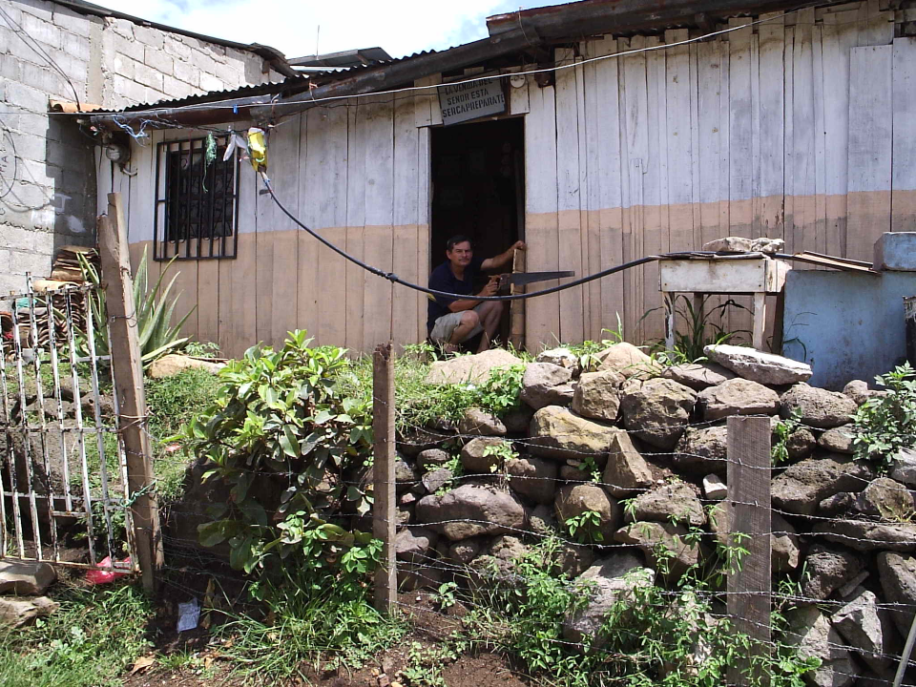
The State of the Planet
Sustainable Development Goals

Slide 2
Class Logistics
Field trip date
Course notes – recommend printing PDF starting with Flow Control and Measurement

Slide 3
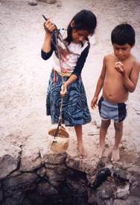
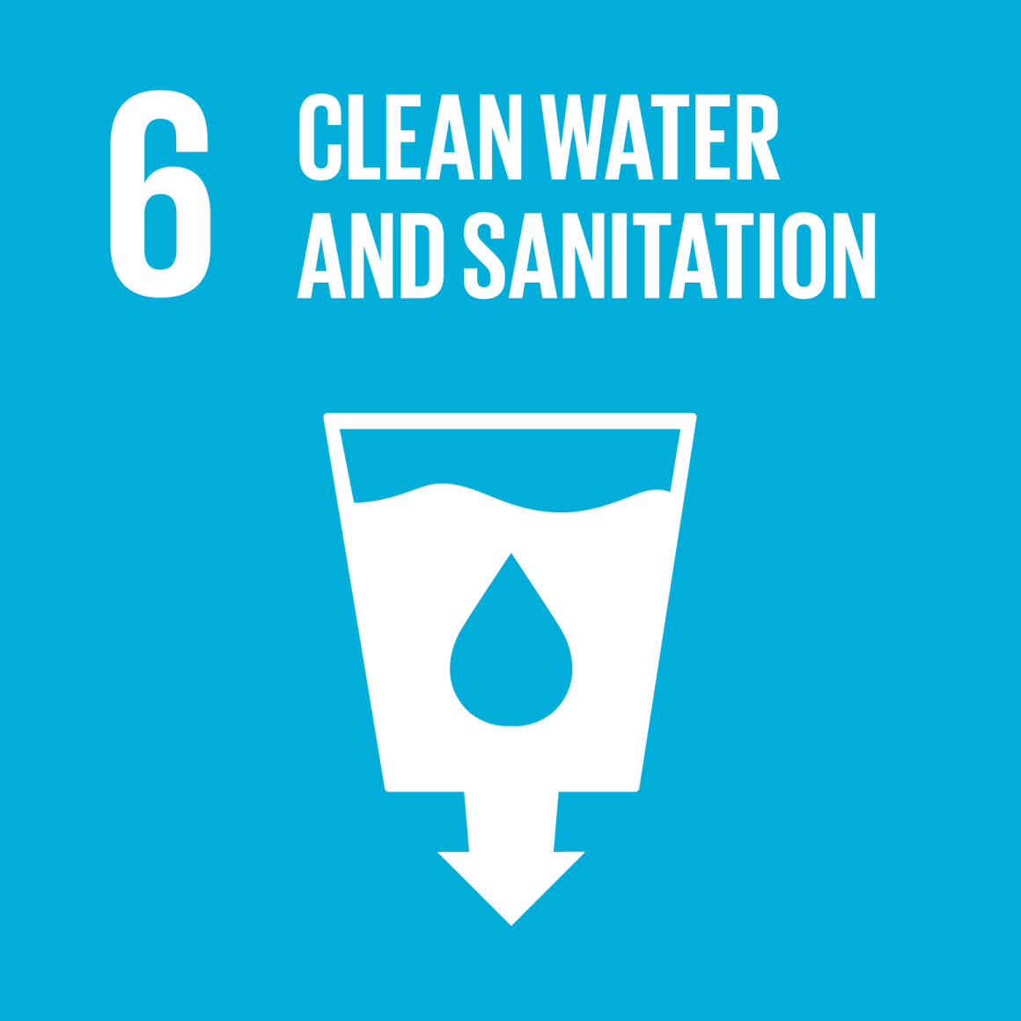
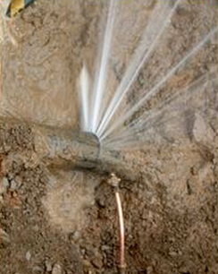
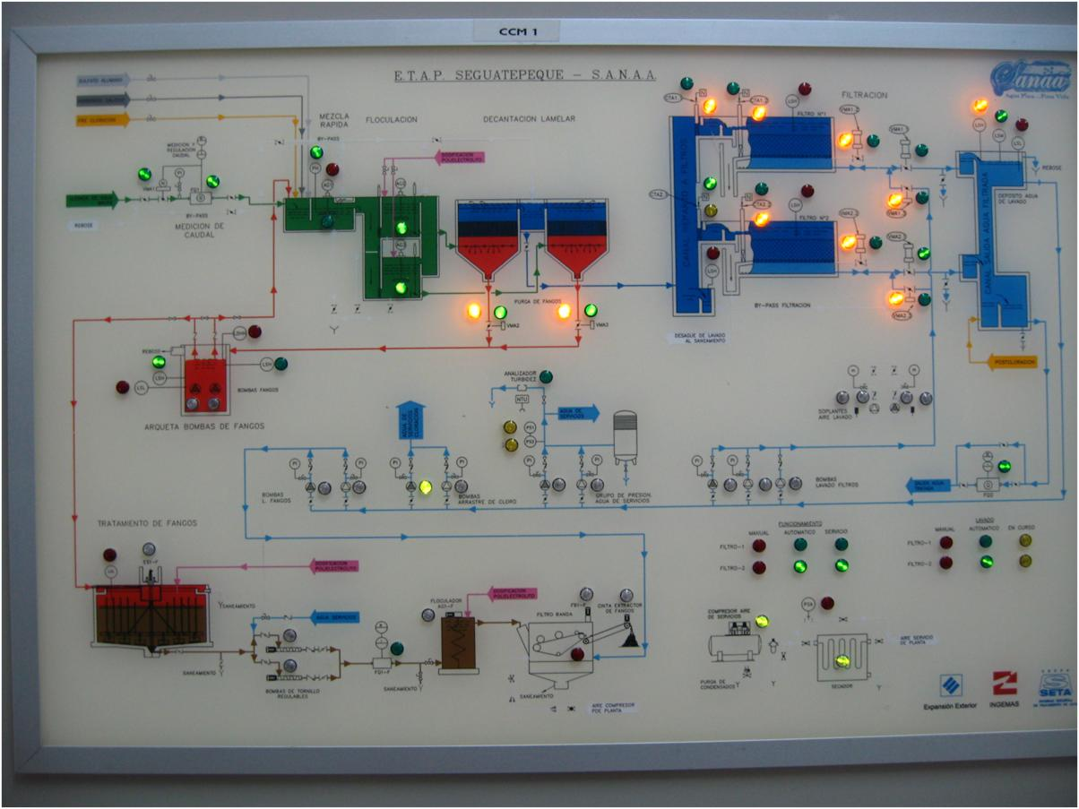
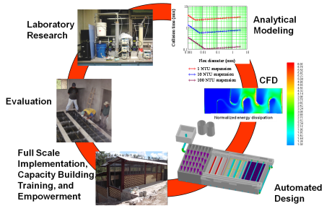
Overview
Burden of unsafe water
The Sustainable Development Goals
Safe and Improved…
Intermittent Supplies
The technology is well developed…
Cell phones vs. municipal water technology
A role for universities
Ctrl + click the pictures to go each section!

Slide 4
Overview
Burden of unsafe water
The Sustainable Development Goals
Safe and Improved…
Intermittent Supplies
The technology is well developed…
Cell phones vs. municipal water technology
A role for universities
Ctrl + click the pictures to go each section!

Slide 5
WHO Fact sheet on water (2017): The good news
(World Health Organization)
“In 2015, 71% of the global population (5.2 billion people) used a safely managed drinking-water service – located on premises, available when needed, and free from contamination.”
But let’s bring skepticism to this statement
This conclusion was made without collecting data on water quality in rural areas
Notes:
http://www.who.int/mediacentre/factsheets/fs391/en/
https://www.ircwash.org/blog/third-glass-three-quarters-full?utm_source=Amplify&utm_campaign=5c4000cc1e-Amplify_Aug_2017&utm_medium=email&utm_term=0_d60e6862b4-5c4000cc1e-48437621

Slide 6
UN Fact sheet on water (2017) The bad news
884 million people lack even a basic drinking-water service, including 159 million people who are dependent on surface water
Globally, at least 2 billion people use a drinking water source contaminated with feces
Contaminated water can transmit diseases such diarrhea, cholera, dysentery, typhoid, and polio
Contaminated drinking water is estimated to cause 502,000 diarrheal deaths each year
Notes:
http://www.who.int/mediacentre/factsheets/fs391/en/

Slide 7
UN Fact sheet on water (2015)
By 2025, half of the world’s population will be living in water-stressed areas
In low- and middle-income countries, 38% of health care facilities lack any water source, 19% do not have improved sanitation and 35% lack water and soap for handwashing
Notes:
http://www.who.int/mediacentre/factsheets/fs391/en/

Slide 8
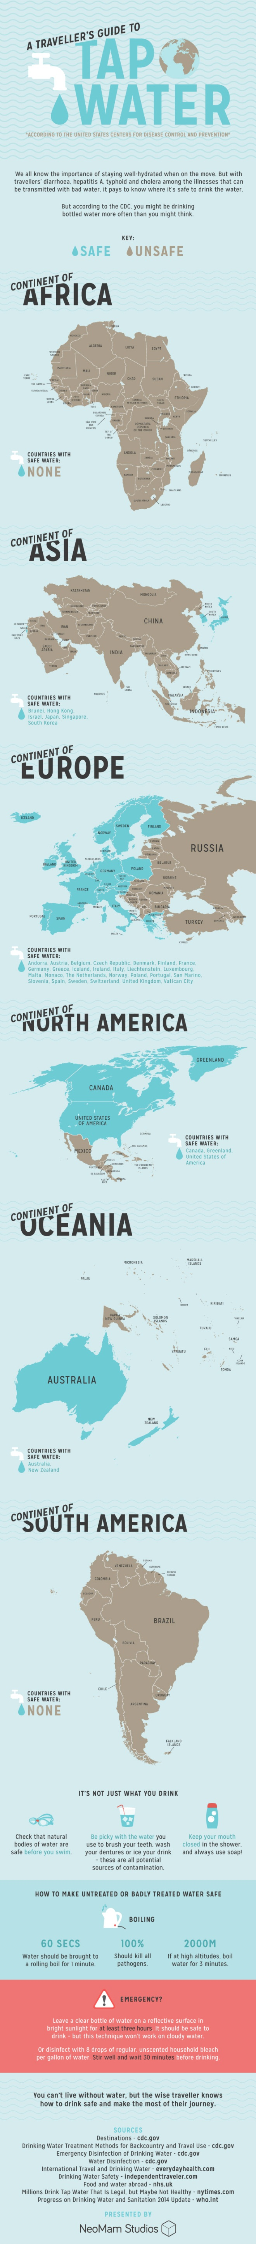
Safe Tap Water According to the CDC
A Traveler's Guide to Tap Water
September 10, 2014 by Danny Ashton
Notes:
A Traveler's Guide to Tap Water
September 10, 2014 by Danny Ashton
http://lifehacker.com/know-what-countries-guarantee-drinkable-tap-water-with-1635070463

Slide 9
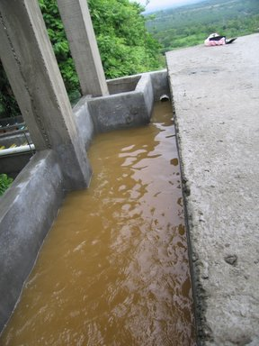
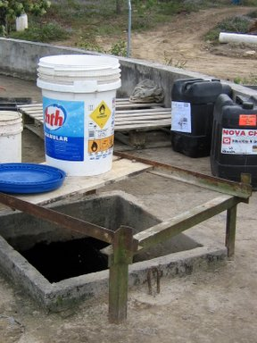
Honduras Stats as of 2015 (from WHO)
Population with sustainable access to an improved water source
Urban – 97.4%
Rural – 83.8%
Notes:
http://apps.who.int/gho/data/node.main.46?lang=en

Slide 10
More Honduras Stats
extra
In 2006, only 75% of the drinking water in urban areas was disinfected^{[2]} and 10% of the wastewater that was collected received treatment.^{[3]}
In rural areas, it was estimated that only one-third of the systems provided continual service and less than 14% of the systems delivered disinfected water in 2004 .^{[4]}
http://en.wikipedia.org/wiki/Water_supply_and_sanitation_in_Honduras

Slide 11
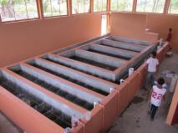
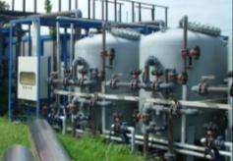
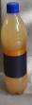
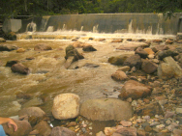
Value of Service and Willingness to Pay
Economics background: cost/quality framework
How do we understand the failure of some systems?
Where is the “sweet spot” for sustainability?
Untreated river water at the tap
Traditional Mechanized plant
AguaClara plant
2
3
Willingness to Pay ($/month)
Service method
Break-even line
Minimum quality for public health
1
Cost of service ($/month)
Notes:
The cases of 1 (small towns less than 25,000) and 2 (towns larger than 25,000) in Honduras are the norm.

Slide 12
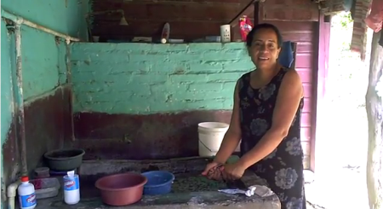
Reina Amador Diaz: Tamara, Honduras
extra
“I used to boil the water for hours and it would still be dirty.” As a cook, Dona Reina saves times by receiving clean water directly into her home. She used to worry about spreading illnesses when she cooked. “Now the water is pure; I know I am serving people healthy, clean food.”
Dona Reina says that the water treatment plant has attracted new residents. “We have cleaner water than the capital!”

Slide 13
Overview
Burden of unsafe water
The Sustainable Development Goals
Safe and Improved…
Intermittent Supplies
The technology is well developed…
Cell phones vs. municipal water technology
A role for universities
Ctrl + click the pictures to go each section!

Slide 14

United Nations
“By 2030, achieve universal and equitable access to safe and affordable drinking water for all”
“Support and strengthen the participation of local communities in improving water and sanitation management” http://www.un.org/sustainabledevelopment/water-and-sanitation/

Slide 15
Overview
Burden of unsafe water
The Sustainable Development Goals
Safe and Improved…
Intermittent Supplies
The technology is well developed…
Cell phones vs. municipal water technology
A role for universities
Ctrl + click the pictures to go each section!

Slide 16
Intermittent Supplies
It is estimated that over one-third of the urban water supplies in Africa, and in Latin America and the Caribbean, and more than half those in Asia, operate intermittently.
Why are supplies intermittent? _______________
Crude form of rationing
Lack of meters
Leaking system – reduce amount of water lost
Some sections of the city might never receive water otherwise
Elevation challenges!
Rolling blackouts
Notes:
http://www.who.int/docstore/water_sanitation_health/Globassessment/Global3.4.htm

Slide 17
You just acquired a hotel in downtown Delhi, India
Electricity is intermittent, what do you do?
Water is intermittent, what do you do?
How can you get more water?
How does each affect your water quality?

Slide 18
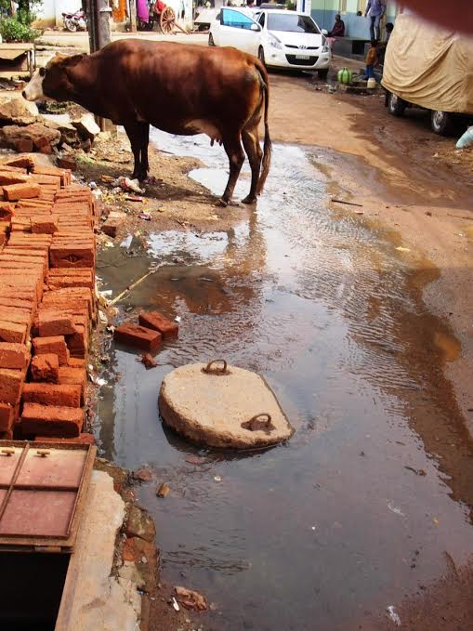
Leaks don’t cause contamination unless the flow is INTO the pipe
Necessary conditions:
Saturated contaminated soil
Leaky Pipe
Pressure outside pipe must exceed pressure inside pipe
Potential Causes:
Negative pressure transients
Booster pumps
*Photo credits
Top: http://texas-slab-leak-repair.com/water_leak
Bottom: Emily Kumple
Notes:
David Gold, Alicia Peters, Weier Chen,Lucia Garcia-Iturri Gallego, Distribution System Contamination Prevention
https://docs.google.com/presentation/d/1FbHpETKLk-6JZaqnlvxxkkQqu3iSUCvia9jvmYfr5kg/edit#slide=id.p21

Slide 19
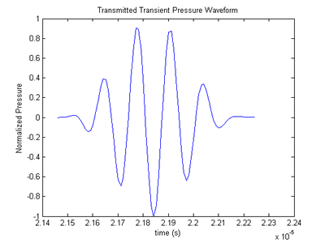
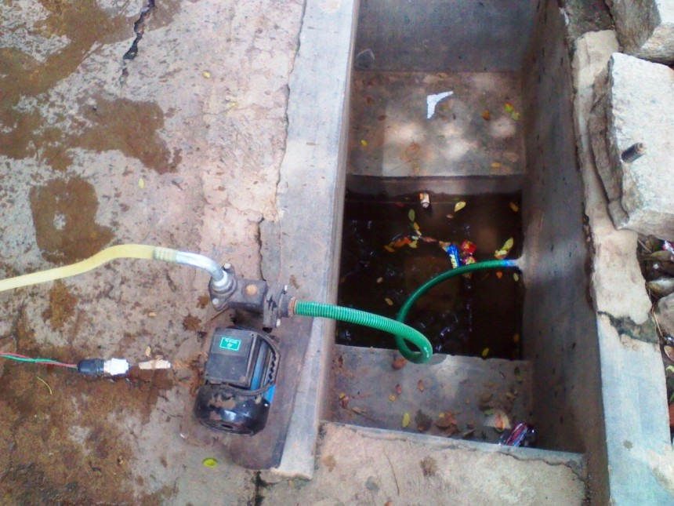
Booster pumps that pull water from the distribution system should be banned
Pressure Transients
Boster Pumps
Image credits: http://www.egr.msu.edu/~fultras-web/images/applications/gui/PressureWaveform.png
Emily Kumple
Notes:
David Gold, Alicia Peters, Weier Chen,Lucia Garcia-Iturri Gallego, Distribution System Contamination Prevention
https://docs.google.com/presentation/d/1FbHpETKLk-6JZaqnlvxxkkQqu3iSUCvia9jvmYfr5kg/edit#slide=id.p16

Slide 20
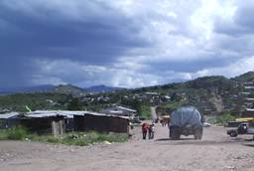
Consequences of Intermittent Supplies
extra
Intermittent water supply is a significant constraint on the availability of water for hygiene
And personal hygiene is very important!!!
Encourages the low-income urban population to turn to alternatives such as water vendors
That are expensive and from dubious sources
Point of Use Storage
That may create risk of contamination
Risks of distribution system contamination
Notes:
http://www.who.int/docstore/water_sanitation_health/Globassessment/Global3.4.htm

Slide 21
Consequences of Intermittent Supplies
extra
Contamination may also occur by intrusion of contaminated water into the pipelines through faulty joints, cracks, etc.
Opportunity for contamination by siphoning
Loss of chlorine residual in stagnant water
The pipelines are subject to additional stress caused by transient flows (water hammer), affecting the durability of the system and weakening pipes and joints (more leaks…)
Water waste increases
Complaints about metering air (if there are meters)

Slide 22
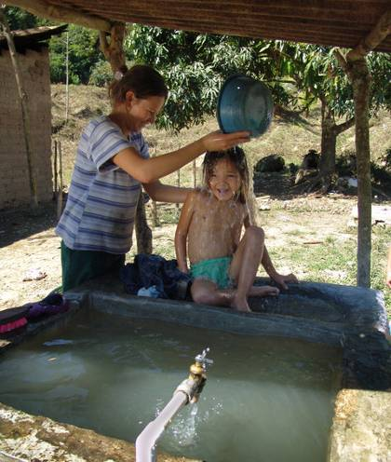
Point of Use (or distributed) Storage
extra
When there is frequent intermittence in the water distribution system, the consumers commonly build or buy domestic storage tanks
Although these devices help to reduce hourly peaks in demand and mask short-term interruptions for users, they are often neither properly protected nor regularly cleaned and disinfected
But they might be a very good idea!
Notes:
http://www.who.int/docstore/water_sanitation_health/Globassessment/Global3.4.htm

Slide 23
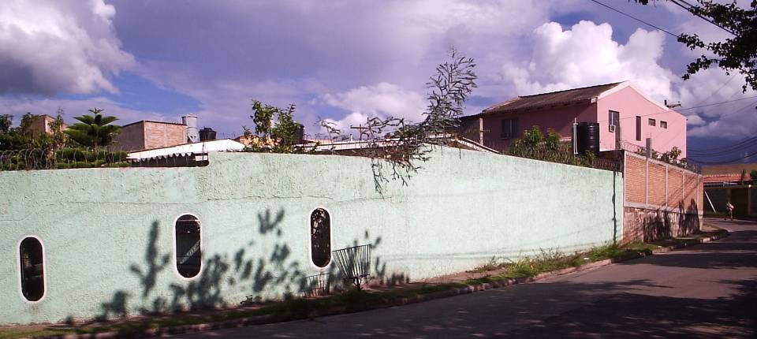
Water Storage Tanks
extra
Photo by Chris Boone

Slide 24
Eliminating Intermittency
extra
Reduce demand – metering
Meters are expensive or (cheaper and unreliable)
Eliminate leaks
Reducing intermittency is a significant engineering and societal challenge
We need engineers and social scientists to work together and come up with techniques to improve distribution system performance when the water supply is limited
Community size may influence the solution

Slide 25
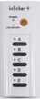
The Point of Use (POU) Treatment Option
extra
A Hypothesis – Given that
centralized water supply systems always have leaks
intermittency is common when water is in short supply
contaminated water can flow into the supply pipes when they aren’t pressurized
Centralized systems often fail to meet standards
Household level (Point of Use) is the best option for drinking water treatment
Notes:
Discuss and then vote

Slide 26
Overview
Burden of unsafe water
The Sustainable Development
Goals
Safe and Improved…
Intermittent Supplies
The technology is well developed…
Cell phones vs. municipal water technology
A role for universities
Ctrl + click the pictures to go each section!

Slide 27
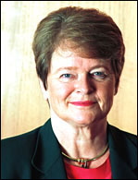
Technology isn’t the problem
Former World Health Organization Director-General: Dr Gro Harlem Brundtland speech at Cornell University in 2005
Loosely paraphrasing…
We have the technology to solve the world’s problems – what is missing is education, institutional capacity, and political will
Notes:
This is the “engineers are irrelevant hypothesis”.

Slide 28
Policy, Education, Institutions
AND
Technologies

Slide 29
Policy, Education, Institutions or Engineering
and
You can sometimes compensate for poor engineering by providing more inputs
Energy – fossil fuels
Education
Money
Management
Labor
You can sometimes reduce this burden on society by improving the technologies
These factors are multipliers!!!!

Slide 30
Multipliers
Energy x Education x Money x Governance x Labor x Technology = ?
1x1x1x1x1x0=0
1x1x½x1x1x2=1

Slide 31
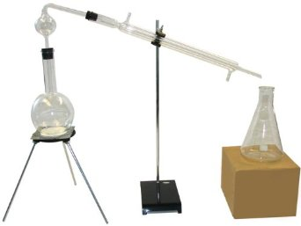
Suppose distillation were the only method that environmental engineers had developed to create clean water
All water in pipes delivered to homes was unsafe
What would you say is the limiting factor preventing implementation of safe piped water?
Weak institutions
Corruption
Weak Economies
Poor education
Inadequate technology
What do you conclude?
Notes:
We have the technology. The problem is weak economies.

Slide 32
Why aren’t there better technology choices?
We have a solution that works for strong economies (conventional water treatment)
Individual cities can’t afford to hire consulting firms to conduct research to develop better technologies
Each city chooses conservative existing designs
The same is true for countries in the Global South (they can’t afford the R&D to develop better technologies)

Slide 33
Continual optimization? Cell Phones vs. Water Treatment
Why are cell phones continually getting cheaper and better?
Why is conventional water treatment not enjoying a similar optimization?
Vendors, Consultants, Municipalities
What does each entity strive to obtain?

Slide 34
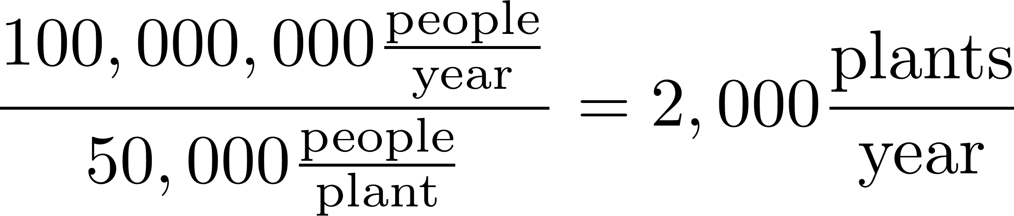
Cell Phones vs. Municipal Water Treatment
Global! | Cell phones | Municipal Water
Units per year | 850,000,000
Companies | 10? | 100s?
Incentive | Improve technology & increase market share | Successful operation at handover of each customized plant
http://www.industry.siemens.com/Water/en/markets/p_02.htm

Slide 35
Why has the Private Sector Failed to Optimize Municipal Water Treatment?
Research and development is expensive
Low volume of units and customized designs for each site
Long life of units
Vendors want to sell hardware
Consultants want to minimize liability for design
Consultants use vendors to create their designs
Vendor designs are patented to maintain market
Can’t risk failure on a unit – conservative design prevails
Ineffective feedback mechanism
Notes:
R&D is expensive

Slide 36
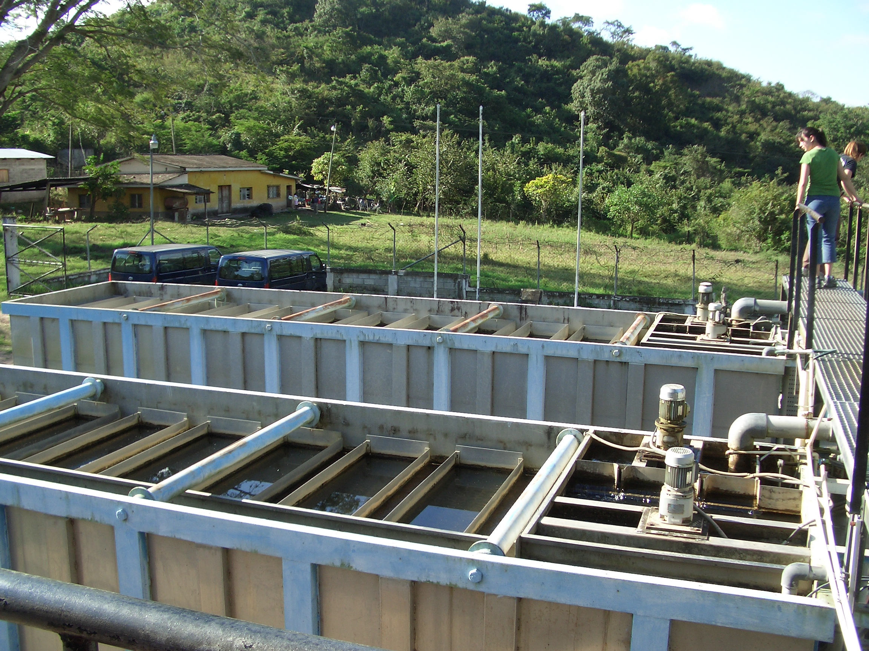
Package Plants

Slide 37
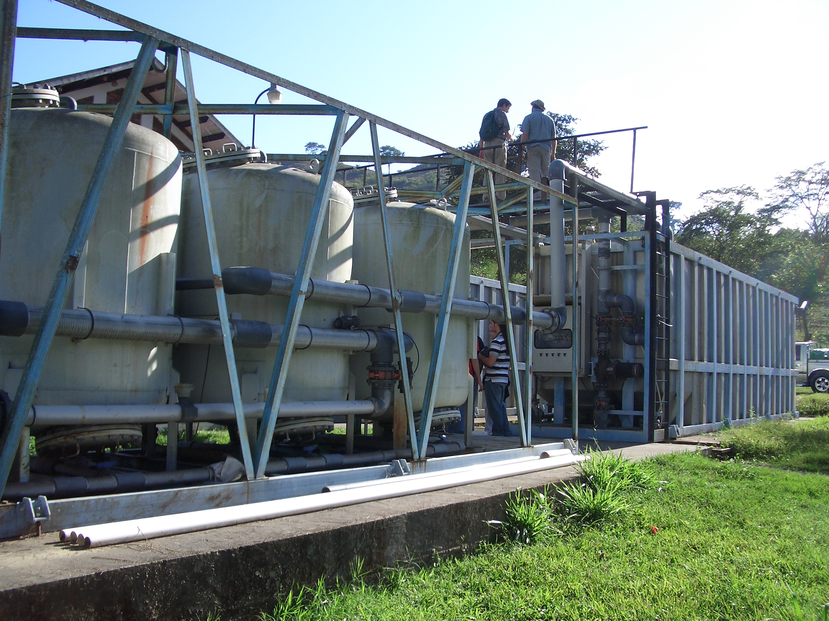
Dominant Design Constraint?
Notes:
What was the constraint used to create this design???? Constraints matter! The design you create will strongly reflect the constraints that you used to guide the design.

Slide 38
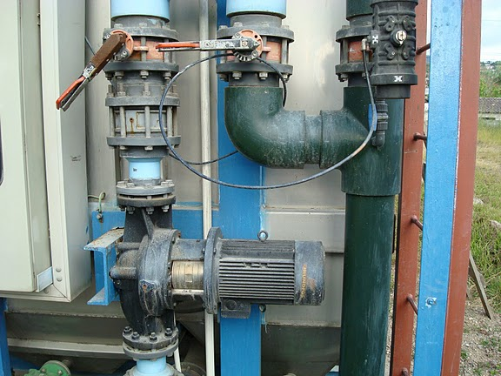

Slide 39

Failure to design for the Operator

Slide 40
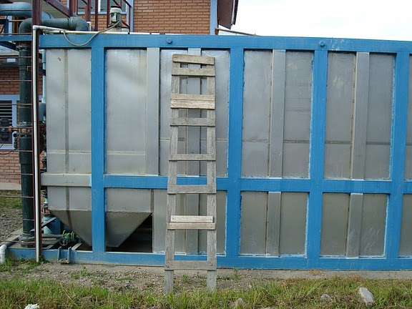
Failure to design for the Operator

Slide 41
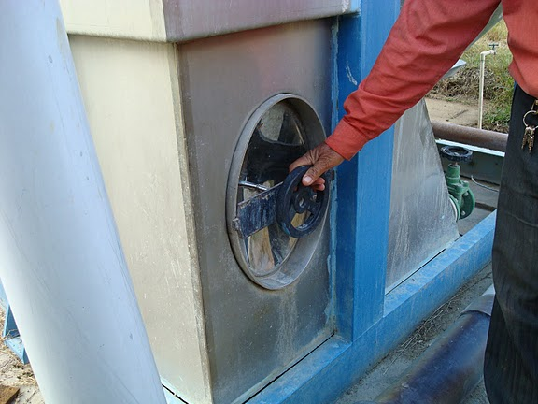
Failure to design for the Operator

Slide 43
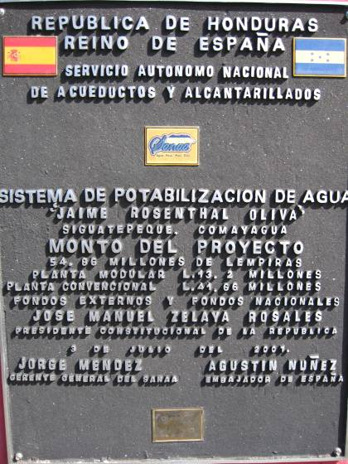
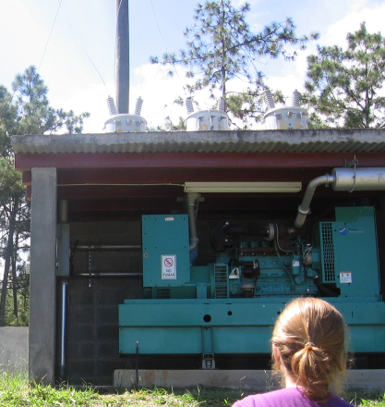
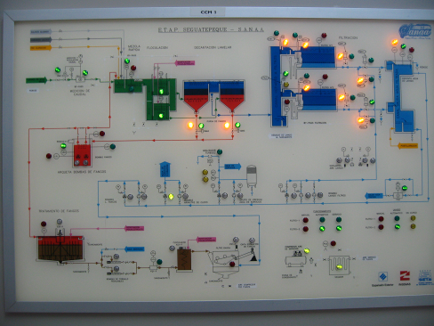
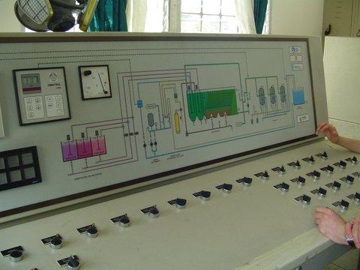
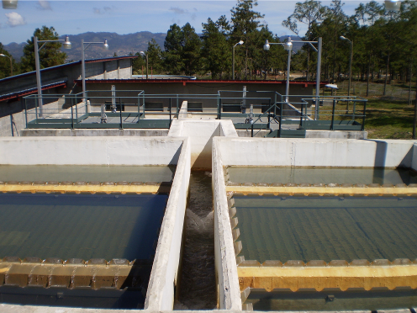
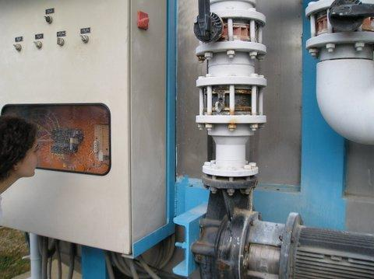
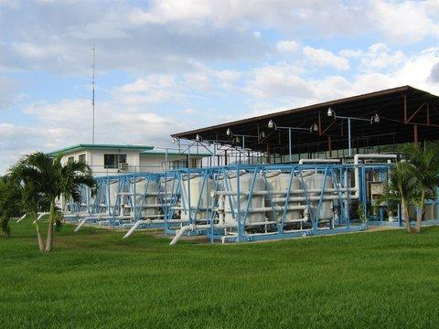
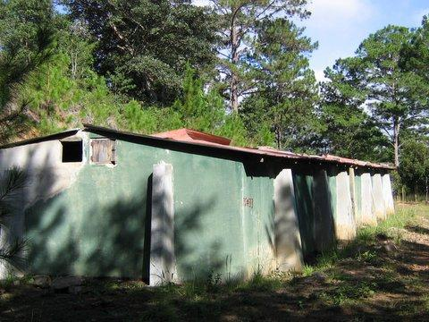
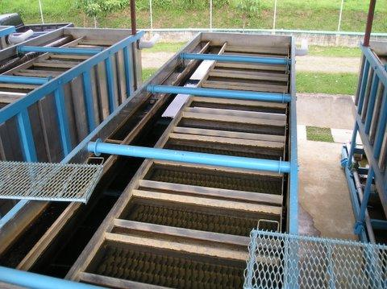
Both “advanced” and “appropriate” technologies can fail
El Progreso,
Modular BEKOX
Vulnerable
Siguatepeque
Civil Work
Vulnerable
Marcala, Honduras
No chemicals
Upflow filtration
Abandoned (Replaced with AguaClara)
4 veces mas cara que AguaClara
Notes:
Ethics of Engineering Experimentation

Slide 44
Overview
Burden of unsafe water
The Sustainable Development Goals
Safe and Improved…
Intermittent Supplies
The technology is well developed…
Cell phones vs. municipal water technology
A role for universities
Ctrl + click the pictures to go each section!

Slide 45
A Role for Universities
Develop new knowledge
Test the designs in full scale field trials
Make that knowledge available to the global community
Open source engineering!
Capacity building: training the trainers
Bring the power of automation to engineering design (Take Henry Ford’s idea out of the realm of widgets and into the realm of knowledge)

Slide 46
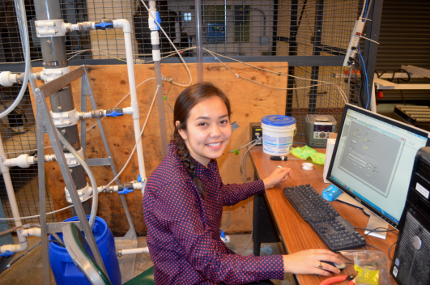
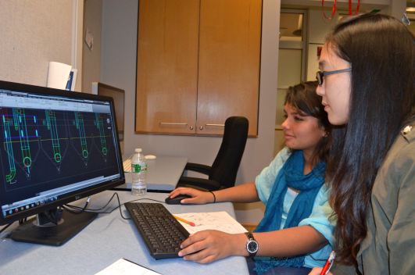
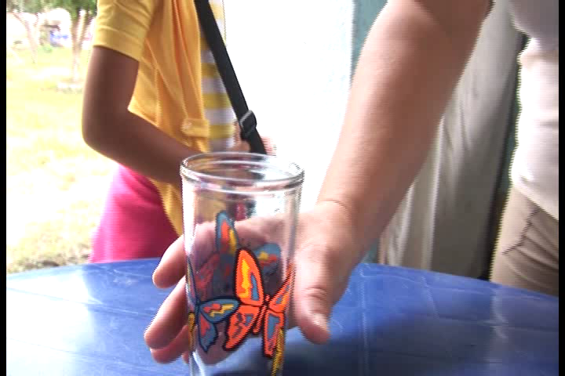
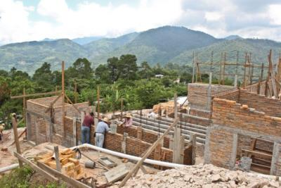
Open-Source University-based Research and Development
New Theories
Research Laboratory
Design Studio
Journey Inward
Journey Outward
Safe water on tap
Sustainable Infrastructure
Notes:
From the research lab to new understanding of the physics to the design studio to the construction site to the tap
"research invent design empower"

Slide 47
Low Carbon Footprint Technologies
Previous generations of engineers designed infrastructure that required cheap fossil fuel
It is long past time for a new paradigm
The original motivation for developing energy efficient technologies was the Global South, but many of these technologies will be the preferred option for wealthier communities too (Everyone likes cheaper, better, more reliable)

Slide 48
Hypotheses: The Grand Experiment
Technology should be designed based on the conditions under which it will operate
For infrastructure it is more efficient to disseminate knowledge than hardware
We can achieve higher coverage using a model of technology dissemination in which we share knowledge openly

Slide 49
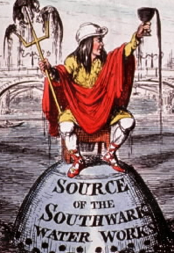
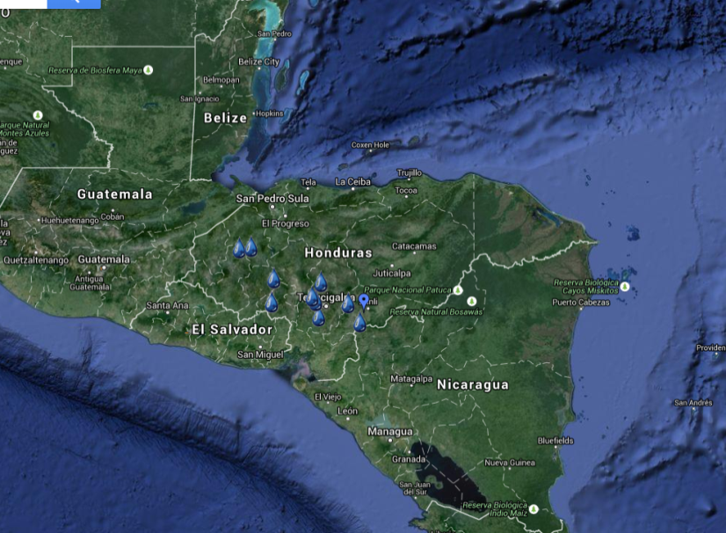
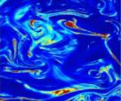
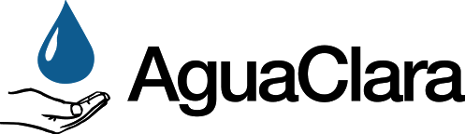
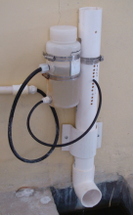
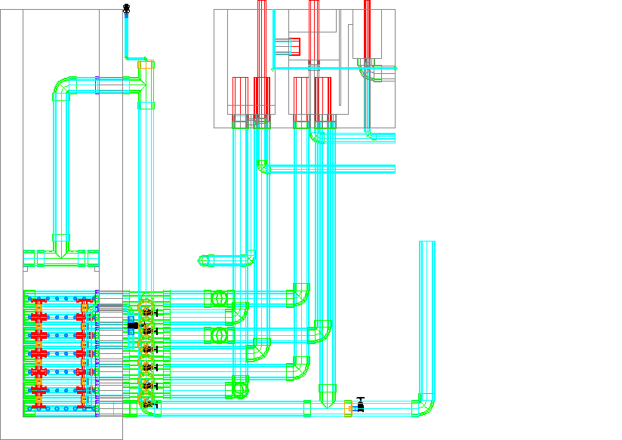
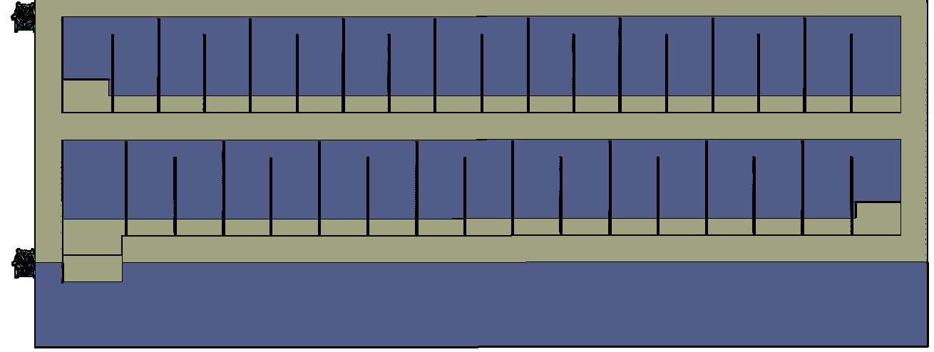
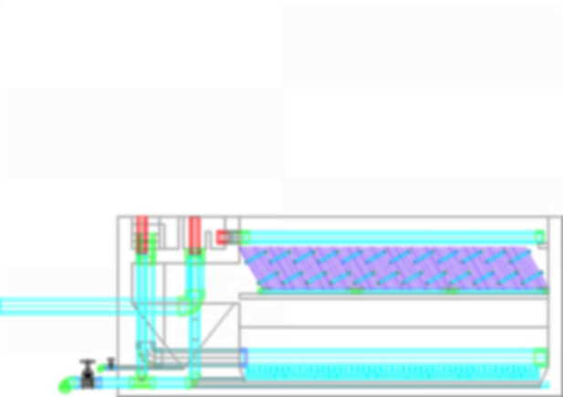
Where are we going?
The Challenge!
Control and measure flow
Rapid Mix
Flocculation
Sedimentation
Filtration
Disinfection

